Slide 1

Dialogflow Training
November 2021

Slide 2

Target
Creating a bot with Concierge and Dialogflow

Slide 3
Target
Creating a bot with Concierge and Dialogflow
Google APIs
Billing
Corpus validation
TTS Tags
Mega Agent
Direct integration with IVR
STT / TTS / SSML
Stackdriver
User Storage
Small talks / Knowledge base / phone gateway
DNN / Tensorflow
Google Home / Explicit invocation

Slide 4
Dialogflow training
Planning
01
Introduction to Dialogflow
08
Firebase Cloud Functions
02
Introduction to STT and TTS
09
Fulfillments
03
Autopsy of a DNN bot
10
Using Google APIs
04
Basic text bot with Dialogflow
11
Integration with Concierge
05
Integration with Google Assistant
12
Integration with Odigo
06
Tuning and learning
13
Tips and tricks
07
Contexts

Slide 5

Dialogflow Training
Module 1 : Introduction to Dialogflow

Slide 6
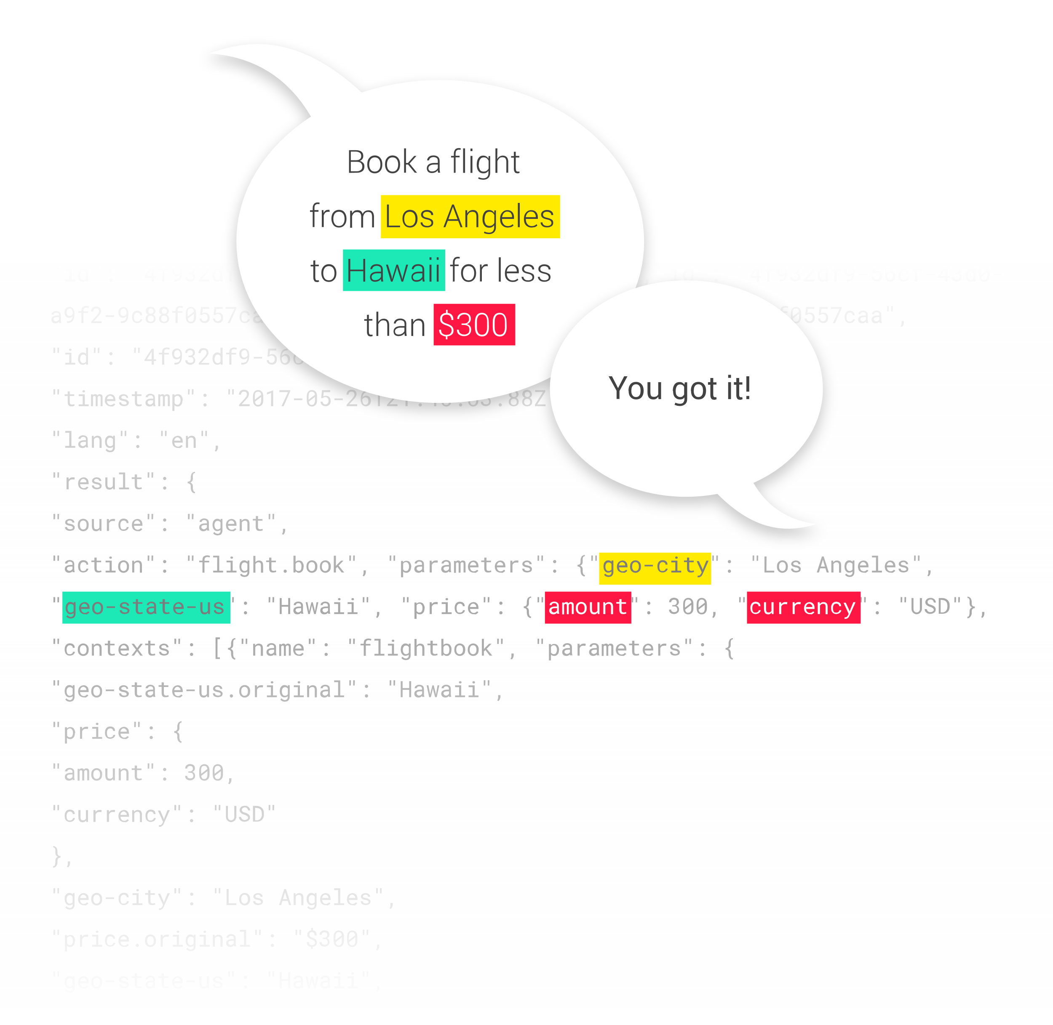
Dialogflow in a few words
Formerly "API.AI", bought by Google in 2016, and renamed "Dialogflow" in 2017
Natural conversation engine (text and voice)
Machine Learning: learning from sample requests, to understand users' intentions
Open: usable with most platforms: Google Assistant, Amazon Alexa, Facebook Messenger, and any device / application by API.
Since July 2018, telephony module.

Slide 7
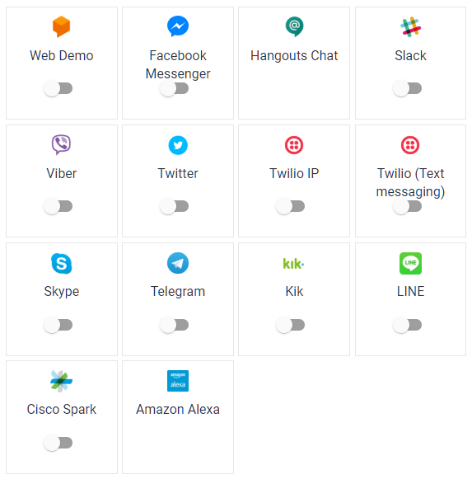

Dialogflow is not only for Google Home

Slide 8
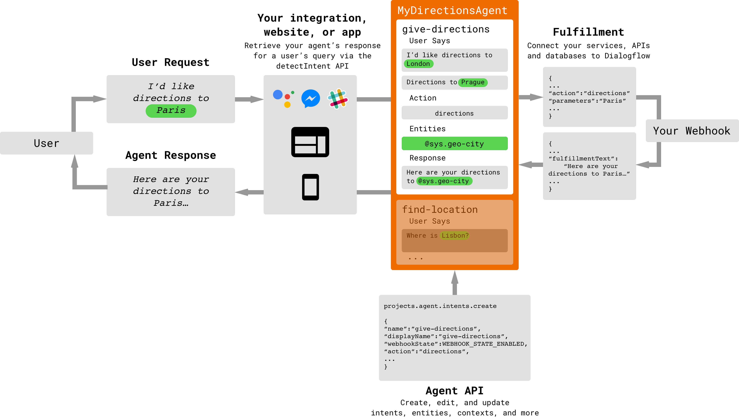
Internal architecture

Slide 9
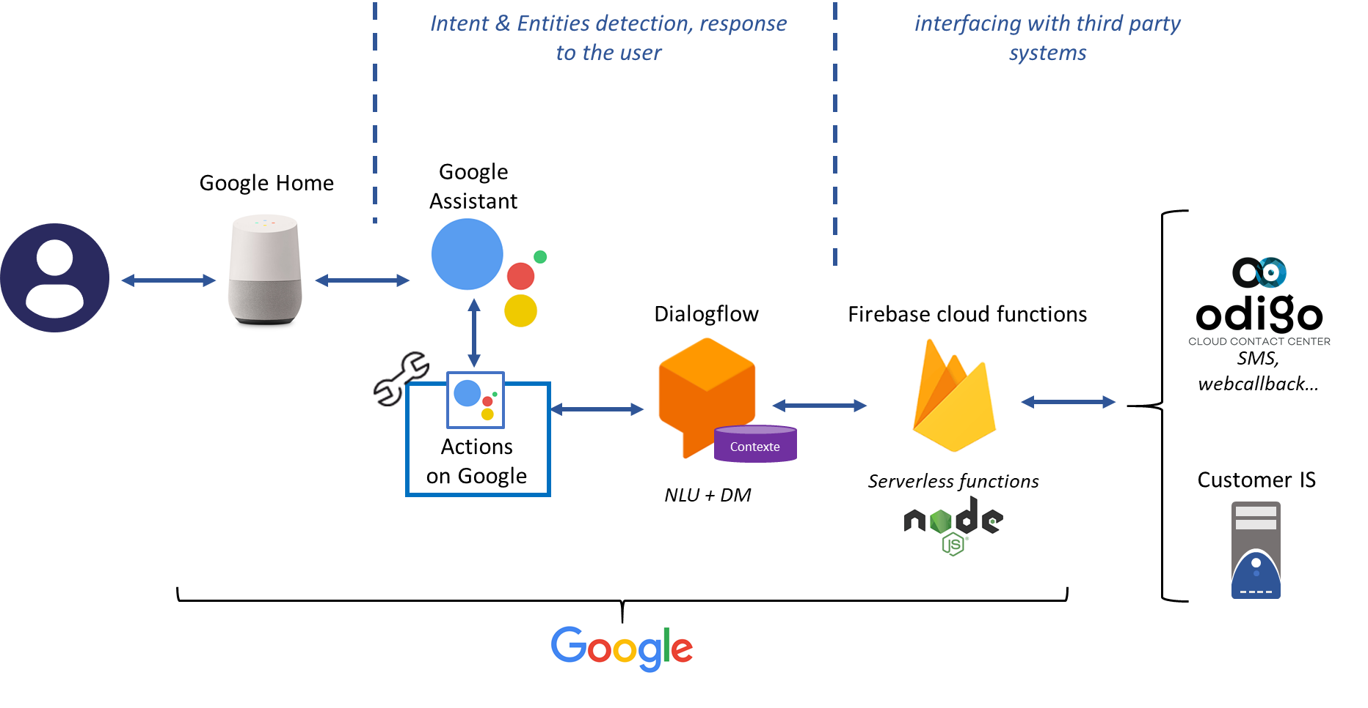
Global native architecture

Slide 10
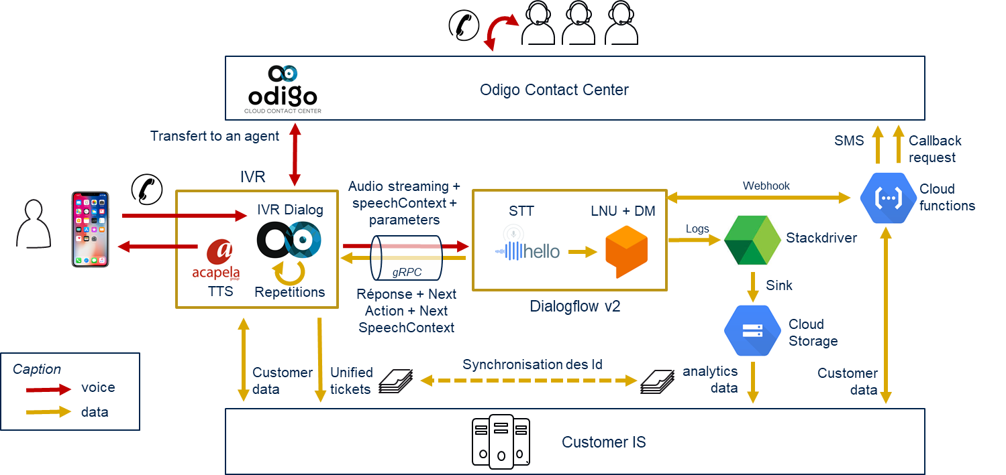
Dialogflow + Odigo IVR

Slide 11





Dialogflow + Odigo Concierge
GW
Proxy
IVR
application
ASR Nuance NR9
TTS Acapela 7
IVR designer
Text only
(no voice)
ASR Nuance NR11
TTS Acapela 8.2
STT Google
TTS Google
Legacy IVR platform
Obsolete legacy component
Callbot & NLP on-demand
Backend Connector
Dialog Manager
NLU
Q&A repository
NLP on-demand to come
Bot « core product »
Third party Bot connector
DialogFlow Connector
Admin UI
NLP
ADMIN & BACKEND
DIALOG MANAGEMENT

Slide 12
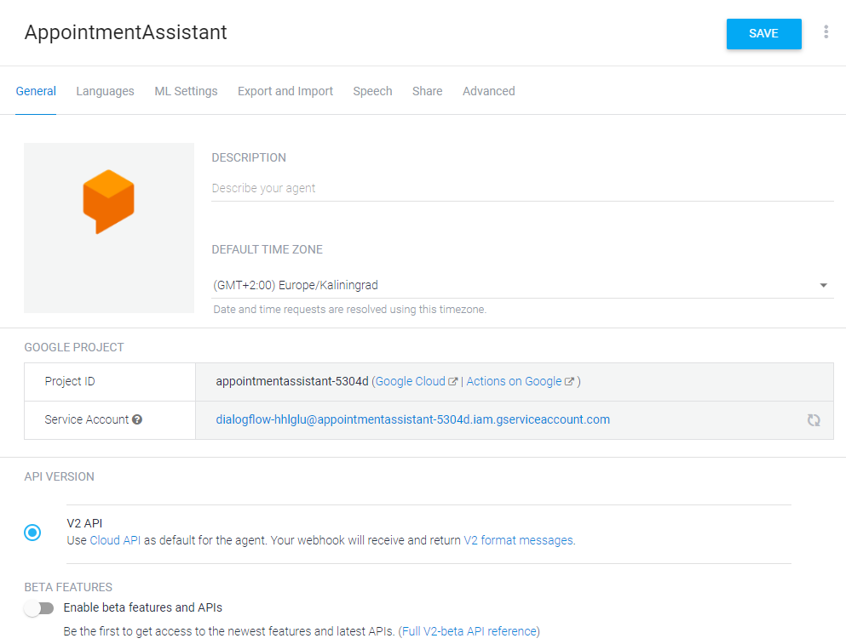
Beta options
BETA
In « Parameters / General », enable the option« beta features and APIs » to use beta options.

Slide 13
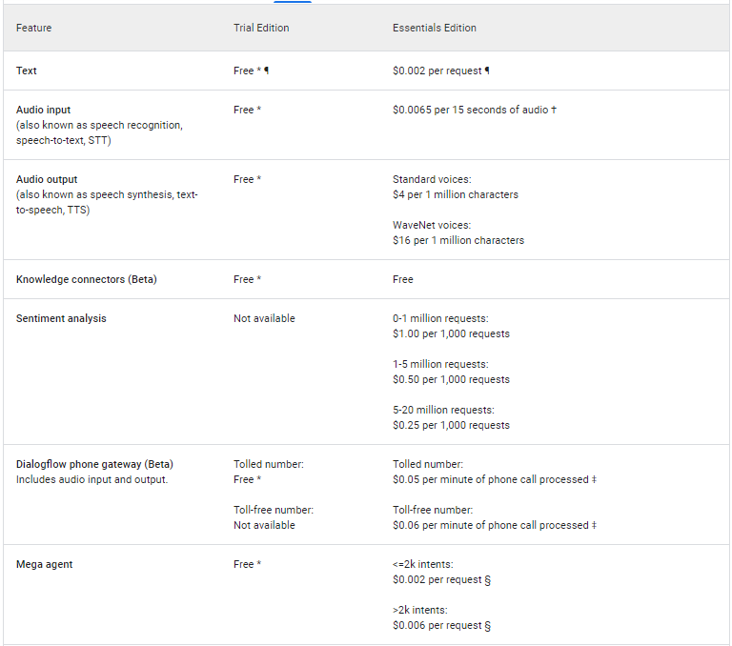
Pricing Plans : Dialogflow ES

Slide 14
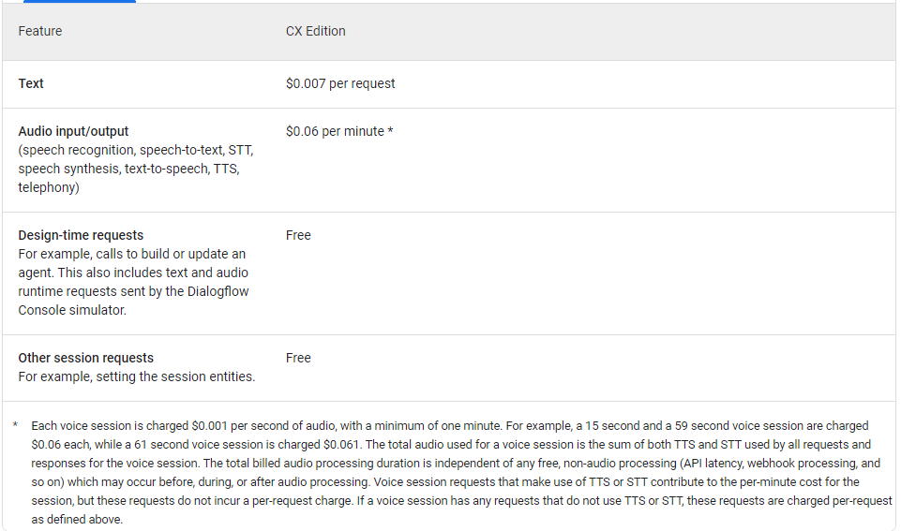
Pricing Plans : Dialogflow CX

Slide 15
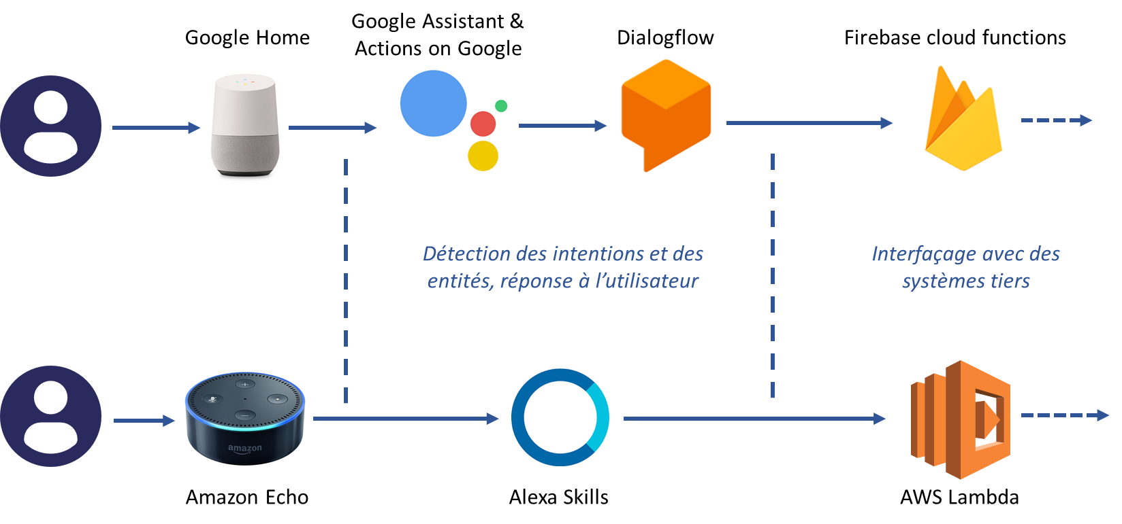
Dialogflow vs Alexa Skills

Slide 16
Dialogflow Training
Module 2 : Introduction to STT / TTS

Slide 17


Google STT and TTS
STT : Speech To Text
The Google Speech-to-Text API enables developers to convert audio to text by applying neural network models.
Returns text transcription in real time
Transcribes proper nouns and context-specific formatting (dates, phones numbers…)
Recognizes 120 languages and variants
https://cloud.google.com/speech-to-text
TTS : Text to Speech
Google Cloud Text-to-Speech API converts text into human-like speech in more than 180 voices across 30+ languages and variants.
Two Voices :
DeepMind WaveNet voices that provide the natural-sounding speech.
Or standard Voices. Less natural, but cheaper.
https://cloud.google.com/text-to-speech

Slide 18
STT – Speech To Text
Basic transcription
“Proud of Odigo”
« Proud of her go »
Transcription with speech adaptation (with a dictionnary)
Feedback:
For a customer, with just 30 words in speechContexts,
the recognition rate has increased by 20 points.
“Proud of Odigo”
« Proud of Odigo »
« Odigo »
« CapGemini »
speechContexts

Slide 19
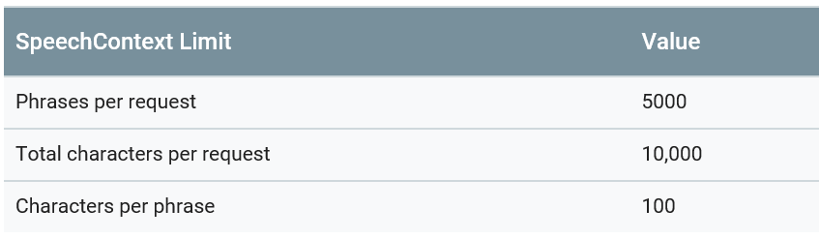
STT – Speech To Text
SpeechContext limits
Remember : the dictionary is fully transmitted in each request.

Slide 20
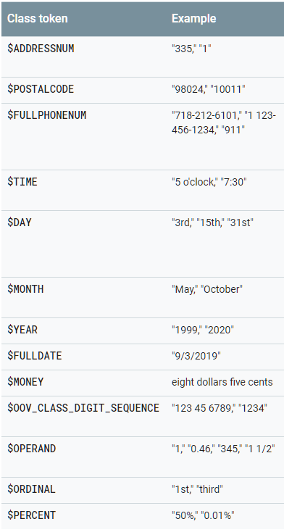
STT – Speech To Text
BETA
Boost:
Value (0 – 20). To amplify the effect of speech adaptation, you can use boost-based adaptation
New Beta options
“aaa”
« aaa »
« bbb »
« ccc »
speechContexts
Classes:
Classes represent groups of words that represent common concepts that occur in natural language.

Slide 21
STT – Speech To Text - Benchmark
We benchmarked Google STT :
Postal adress : OK
IBAN (alphanumeric) : KO
Emails : KO
First name / second name : OK
Numbers : OK

Slide 22
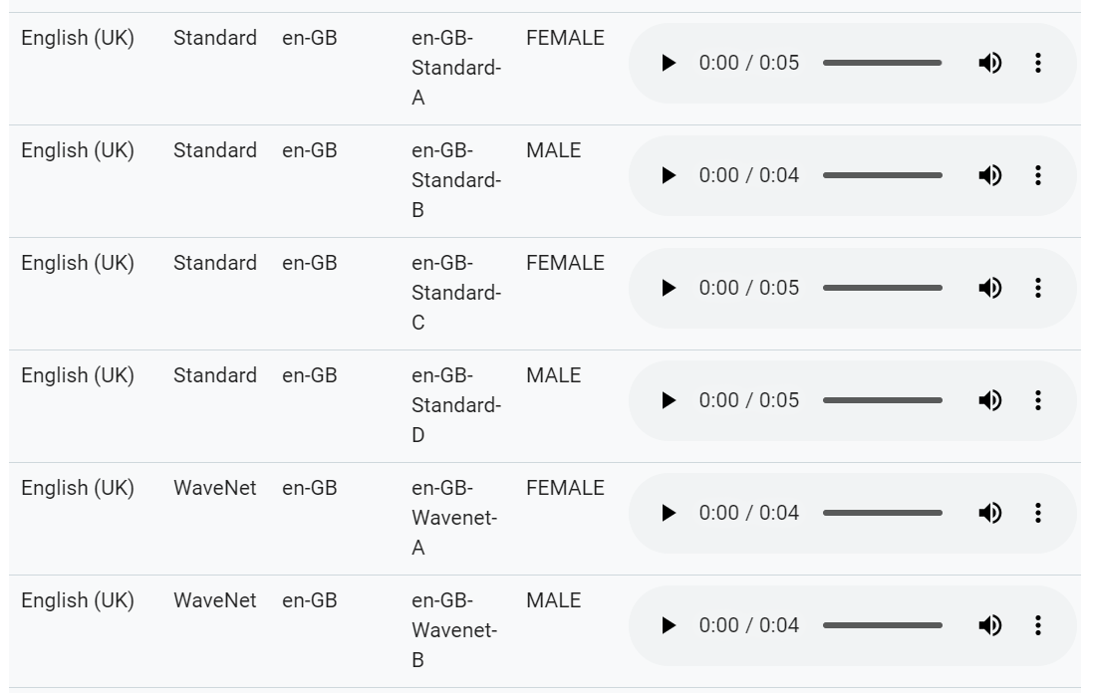
TTS – Text To Speech
The voices can differ in how they are produced.
One common speech technology, parametric text-to-speech, typically generates audio data by passing outputs through signal processing algorithms.
Google introduced a new way to generate audio : WaveNet. A Wavenet model creates raw audio waveforms from scratch. The model uses a neural network that has been trained using a large volume of speech samples.
With Google Speech, you can use « standard » or « Wavenet » voices.
https://cloud.google.com/text-to-speech/docs/voices

Slide 23
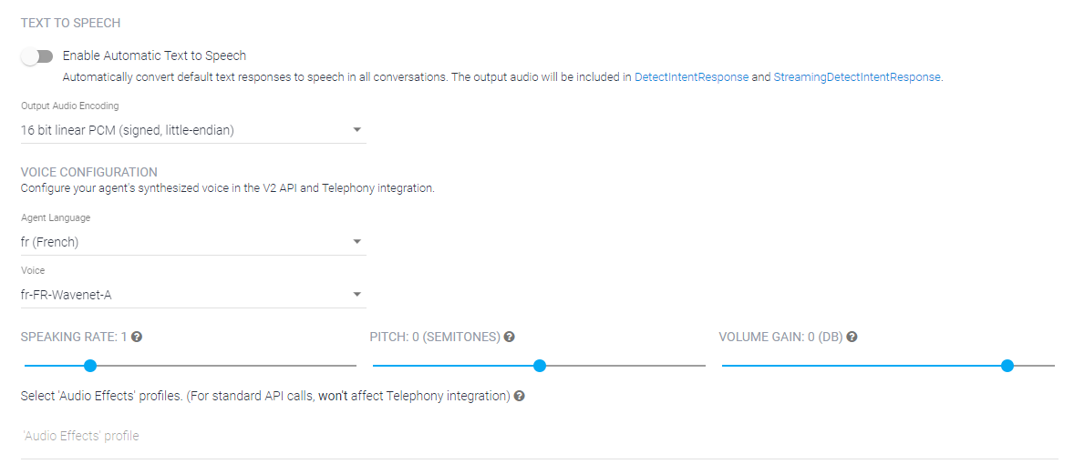
TTS – Text To Speech
Speech Synthesis Markup Language (SSML)
<speak>
<p><s>
<emphasis level="strong">
Mais vous savez,
</emphasis>
moi je ne crois pas qu'il y ait de bonne ou de mauvaise situation.
</s><s>
<break time="800ms"/>
<prosody rate="slow">
Moi, si je devais résumer ma vie aujourd'hui avec vous,
</prosody>
je dirais que c'est d'abord <emphasis level="strong">des rencontres</emphasis>, des gens qui m'ont tendu la main, peut-être à un moment où je ne pouvais pas, <break time="200ms"/> où j'étais seul chez moi. </s>
<break time="1000ms"/>
<s>
<prosody rate="slow">
<emphasis level="reduced">
Et c'est assez curieux de se dire que les hasards, les rencontres, forgent une destinée...
</emphasis>
</prosody>
</s></p>
</speak>
youtube.com/watch?v=X2-bXTl1-mo

Slide 24
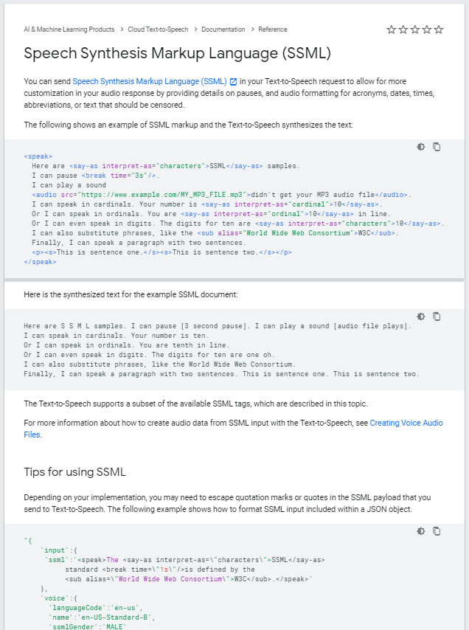
TTS – Text To Speech
All about the SSML :
https://cloud.google.com/text-to-speech/docs/ssml
Tags (speak / p / s / prosody / emphasys / break / say-as …)
Exemples
Tips
…

Slide 25
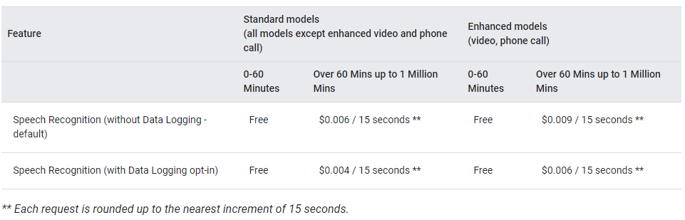
Google : STT Billing
English only
(not French)
14 seconds: $0.009
16 seconds: $0.018
With data logging, customers can allow Google to record audio data sent to Cloud Speech-to-Text. This data helps Google to improve the machine learning models used for speech transcription. Be careful with GDPR.

Slide 26
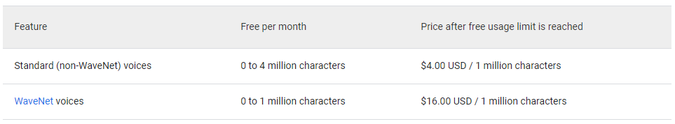
Google : TTS Billing
1 minute of speaking = 1200 characters
Best quality
10 seconds : $0,0032
60 seconds: $0.0192
Notes:
The number of characters includes alphanumeric characters, punctuation, and white spaces.
The SSML tags are included in the character count for billing purpose.
A multiple bytes character (UTF-8) will be charged as only one character.

Slide 27
Dialogflow Training
Module 3 : Autopsy of a DNN BOT

Slide 28
Basic concepts
Intents: intents include elements and logic to parse user’s information. This maps what the user says with response. Intents have several components: contexts, training phrases, events, fulfillment, and response.
Training phrases: different variations of how the same question can be asked by a user. The more variation is added, the better agent can understand
Entities (or slot, attributes): information extracted from users' sentences. There are a variety of entities: system entities to include information about time, weather/location entities… and custom entities.
Fulfillment : The bot sends the request to fetch data needed. Webhook determines how it would like to respond and send back to dialog.
Response: The backend system including webhook, entities, intents, user says… would produce a set of response
Context: Contexts are used to store parameter values for different types of intent in a conversation.

Slide 29
Additional concepts
Incidental conversation: sub conversation during a main conversation, with return to the main conversation at the end.
(conversation for an appointment request)
By the way, is there a bus station near your office ?
Yes, just in front of the door !
(return to the next step of the appointment request)
Smalltalks: technically, smalltalks are useless for handling the user's request. But they allow to humanize the conversation of the bot :
How are you ?
Are you a robot ?

Slide 30


Elements of a conversation
Hello !
Hello, what do you want?
I would like a 4 cheese pizza
What size?
Medium, please
Fine. Your pizza will be ready in 30 minutes.
By the way, is there oregano?
No, never on a 4 cheese pizza !
Ok, see you later
See you later

Slide 31
Elements of a conversation
Hello !
Invocation
I would like a 4 cheese pizza
Intent
Entities
Medium, please
By the way, is there oregano?
Intent attached to a particular context
Ok, see you later

Slide 32
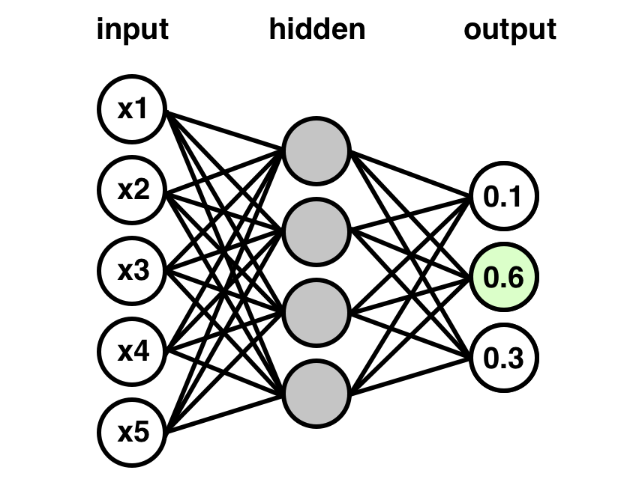
Classification of intents
Training phrases / intents
Learning is the adaptation of the network to better recognize intents by considering training phrases. Learning involves adjusting the weights of the network to improve the accuracy of the result.
Sentence
Intent

Slide 33
How to write training phrases
Google requirement :
Write more than 10 phrases. Less than 2000.
That’s all.

Slide 34
How to write training phrases
General advices :
Expressions have to be very specific to the topic. A phrase must apply to an unique contexts.
Don’t use “I lost it” but “I lost my password”
No overlap allowed. Intents must not be close to each other. Make sure your intents are properly aligned and do not overlap.
Avoid filler words.
Don’t write “hello I forgot my password, Thanks !” but just “I forgot my password”
Varied vocabulary (I forgot, I lost, I can’t remember…)
Varied sentences structures (My password is lost…)
Avoid overfitting : if you don’t vary vocabulary /sentences structures, an intent can become predominant.
an intent with 30 ‘I want to…’
And try to have intentions with balanced training phrases.

Slide 35
Dialogflow Training
Module 4 : Basic text bot

Slide 36
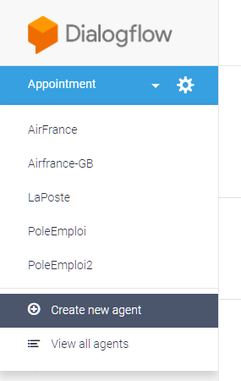
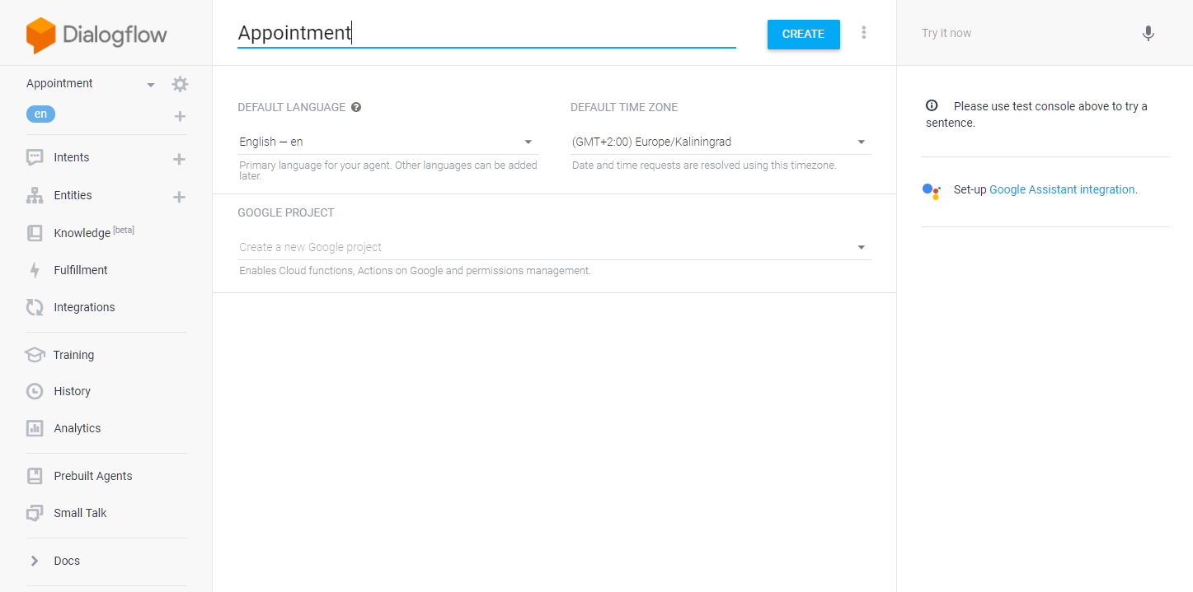
Create a new agent

Slide 37
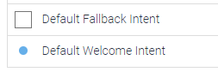
Default Welcome Intent / Default Fallback Intent
Default Welcome Intent :
When an user begins a new conversation with a device (like a Google Home), an event “Welcome” is sent to Dialogflow.
The “default intent” is triggered.
Usage : “Hello ! What can I do for you today?”
Default Fallback Intent :
Fallback intents are triggered if a user's input is not matched by any of the regular intents.
Usage : “I did not understand you, can you rephrase ?”

Slide 38
Use case
Hello, can I help you?
Hello, can I help you?
I would like to have an appointment tomorrow with Dr. Martin
I would like to have an appointment
With witch doctor?
Ok. I propose an appointment with Dr. Martin on September 15th at 9am
Dr. Martin
What day?
September 15th
Ok. I propose an appointment with Dr. Martin on September 15th at 9am

Slide 39
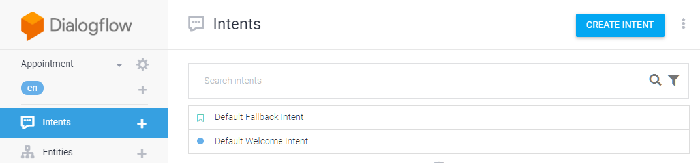
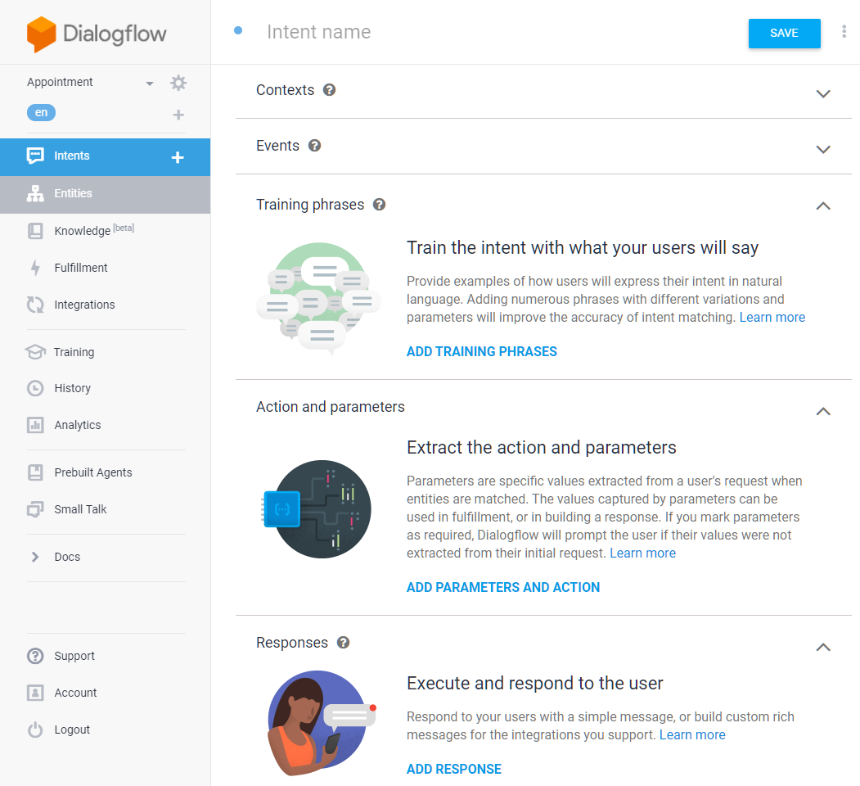
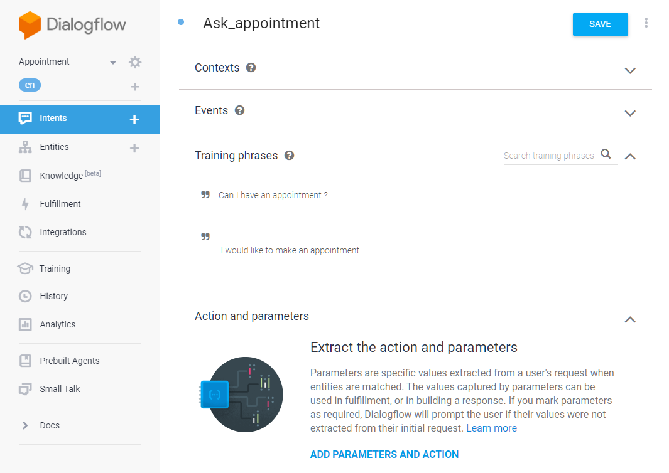
Create a new intent : training phrases

Slide 40
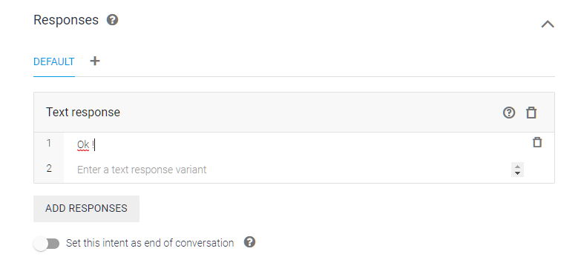
Create a new intent : responses

Slide 41
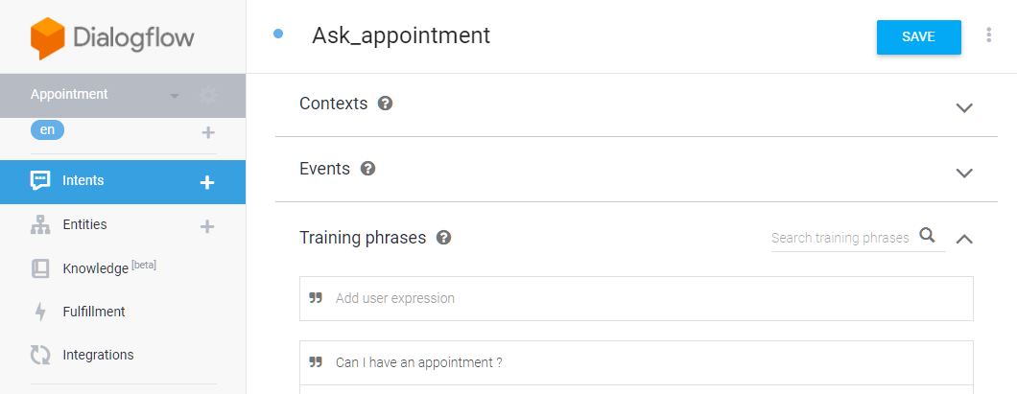
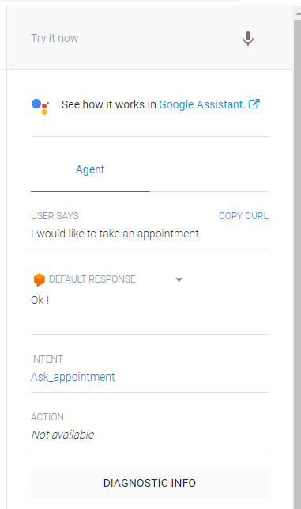
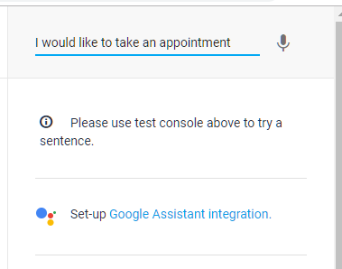
Save & Test

Slide 42
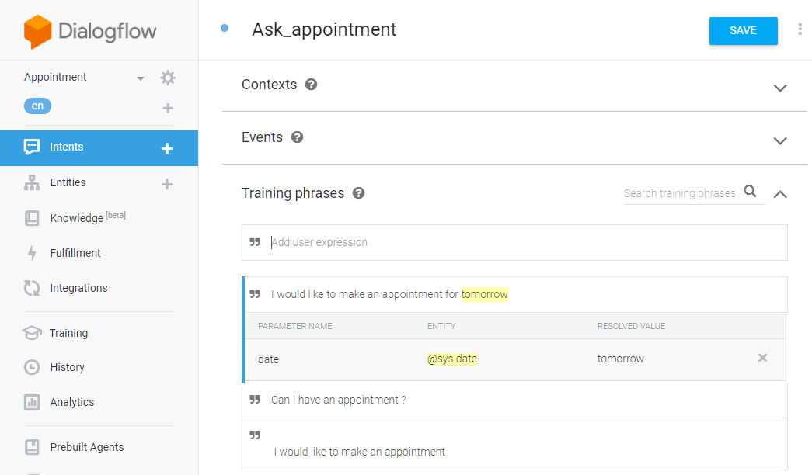
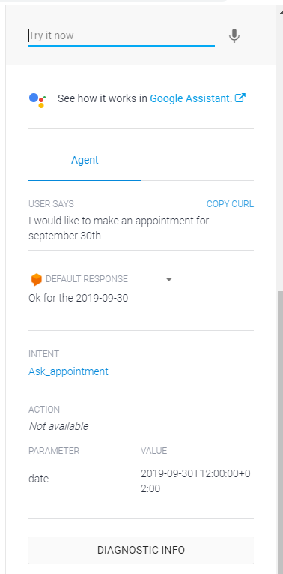
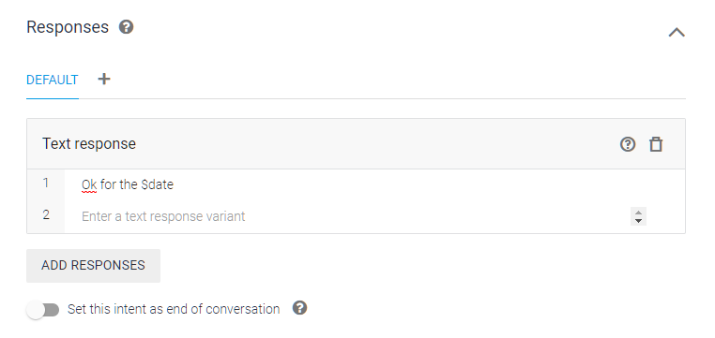
Add system entities

Slide 43
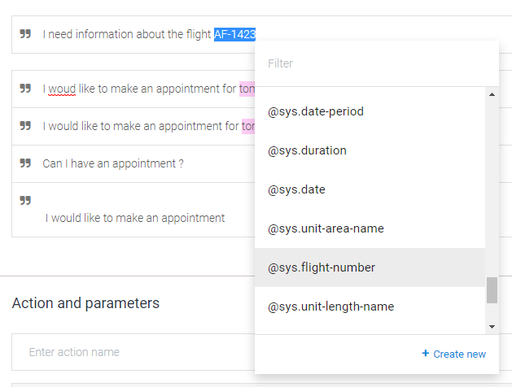
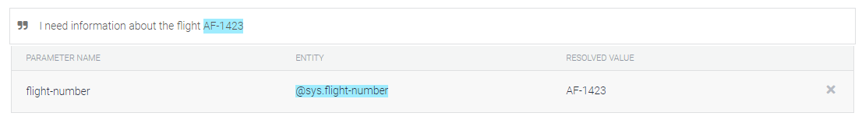
Tag / untag with an entity
Tag : select words and select entity
Untag : delete entity

Slide 44
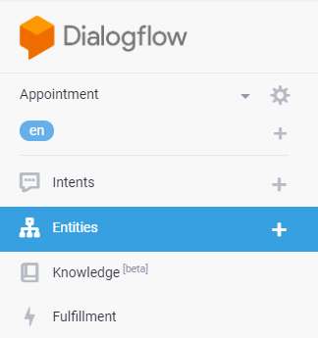
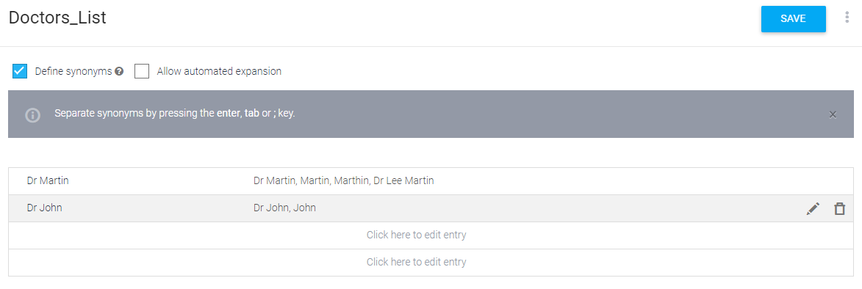
Add custom entities
Value of the item
Synonyms of the item

Slide 45
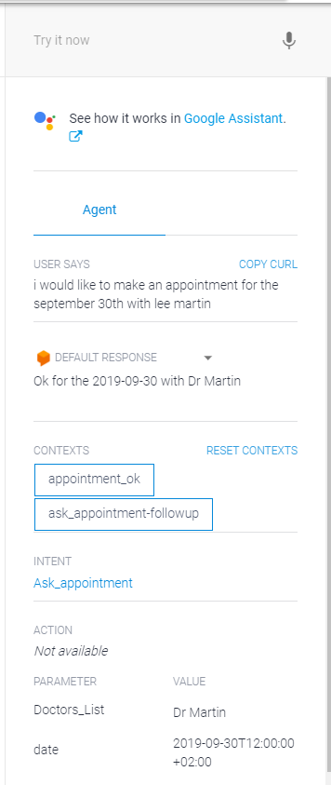
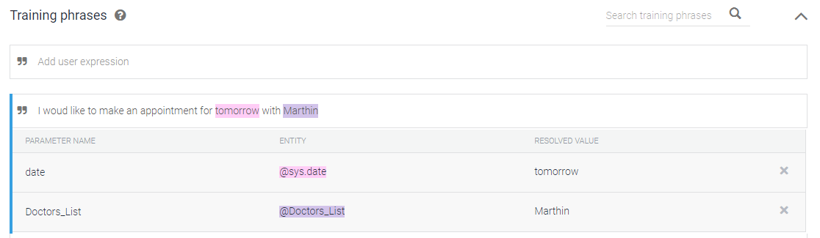
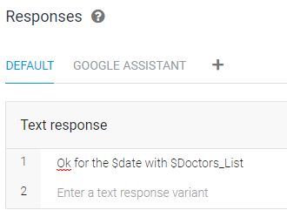
Add custom entities

Slide 46
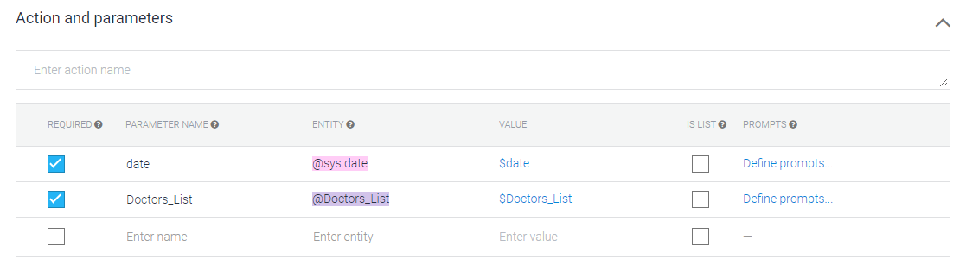
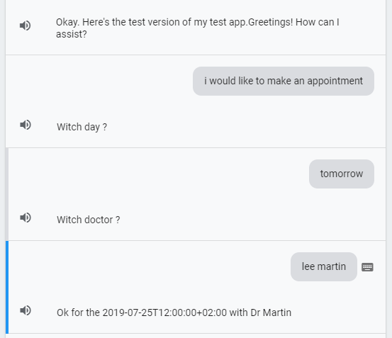
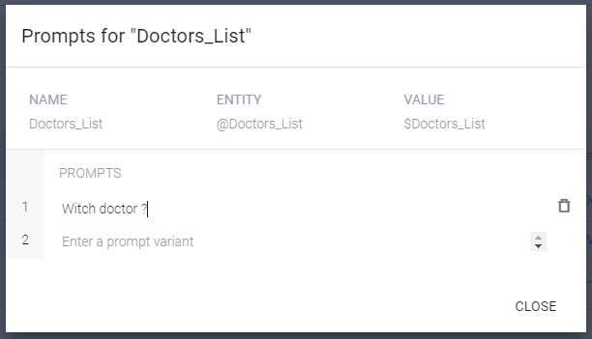
Secondary questions to get the entities
In an intent, some entities may be mandatory (required). If so, a sub-question may be needed to enter this value.

Slide 47
Small talks
Incidental conversation: sub conversation during a main conversation, with return to the main conversation at the end.
(conversation for an appointment request)
By the way, is there a bus station near your office ?
Yes, just in front of the door !
(return to the next step of the appointment request)
Small talks: technically, small talks are useless for handling the user's request. But they allow to humanize the conversation of the bot :
How are you ?
Are you a robot ?

Slide 48
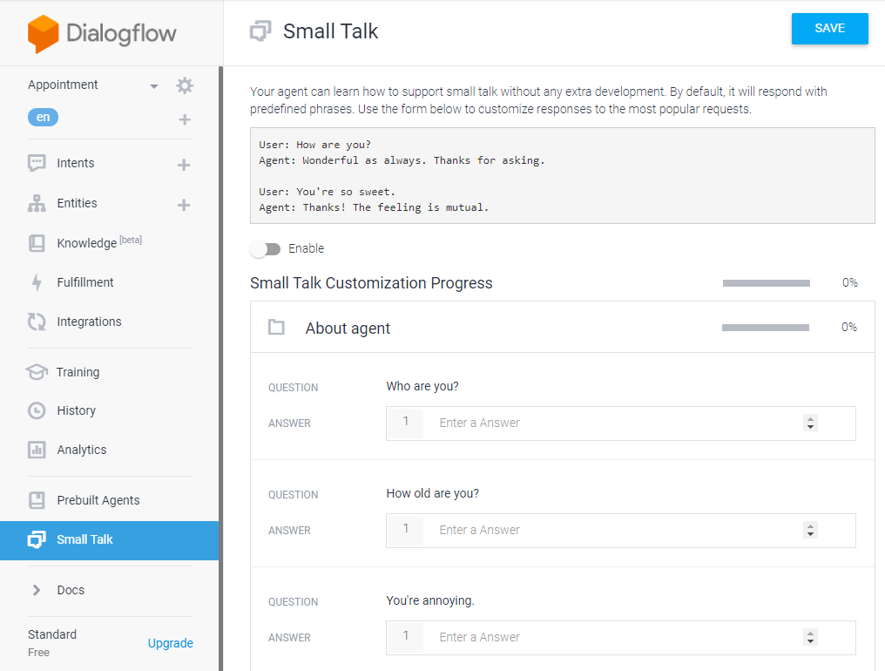
Small talks

Slide 49
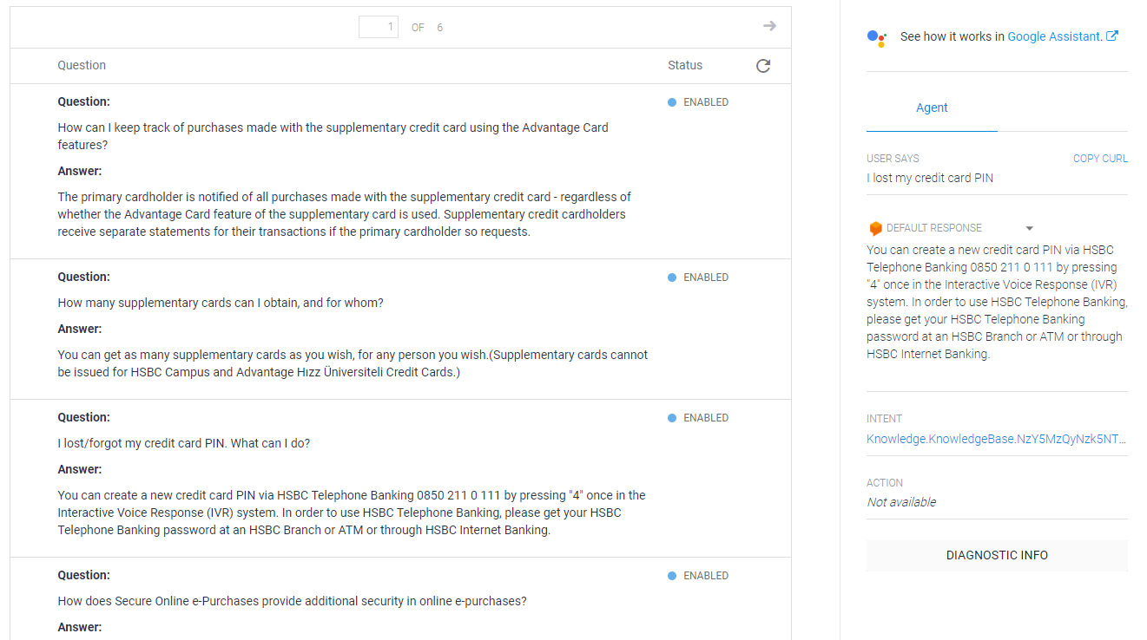
Beta : knowledge base
BETA
https://www.hsbc.com.tr/en/frequently-asked-questions-faq/cards/hsbc-advantage-credit-cards

Slide 50
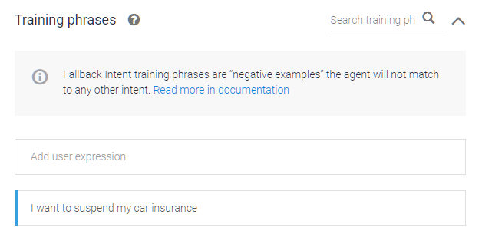
Fallback / Negative exemples
BONUS
Intents
You can add training phrases to fallback intents that act as negative examples. There may be cases where user queries have a slight resemblance to your training phrases, but you do not want these queries to match any normal intents.
Modify_Insurance
I want to change my car insurance
I want to modify my car insurance
I want to suspend my car insurance
Modify_Insurance
I want to change my car insurance
I want to modify my car insurance
Default fallback
I want to suspend my car insurance
I want to suspend my car insurance

Slide 51
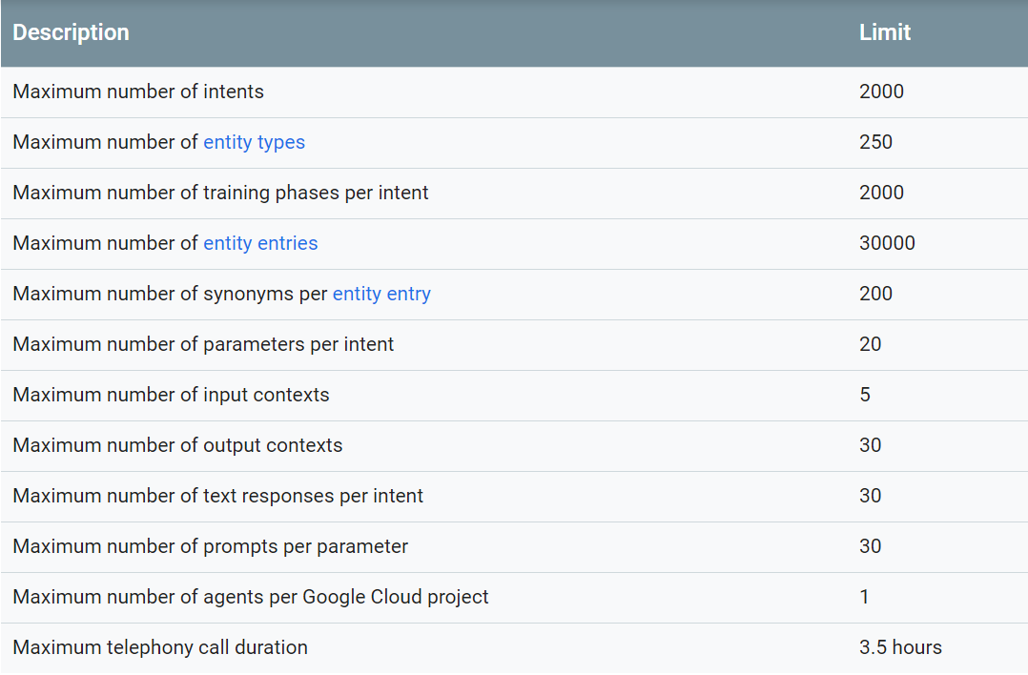
Agent limits

Slide 52
Workshop : ordering a pizza
WORKSHOP
Hello, may I help you?
Modify the “default intent” for the welcome message
Add a new “ordering pizza” intent, with two mandatory custom entities
I would like to order a pizza
What kind ?
New entities to create :
SIZE
Small
Medium
Large
PIZZA
Tuna
Neapolitan
Sicilian
Thuna
What size ?
Medium
Ok. Your Tuna Medium Pizza wil be ready in 20 minutes.
(End of conversation)

Slide 53
Dialogflow Training
Module 5 : Integration with Google Assistant

Slide 54
Global native architecture

Slide 55
Limitations with GCP projects
The number of projects is limited. You must try to :
Reuse existing projects, without creating new ones
Delete old projects
You can’t delete a project immediately: the technical delay is one month. During this month, your project is still active.

Slide 56

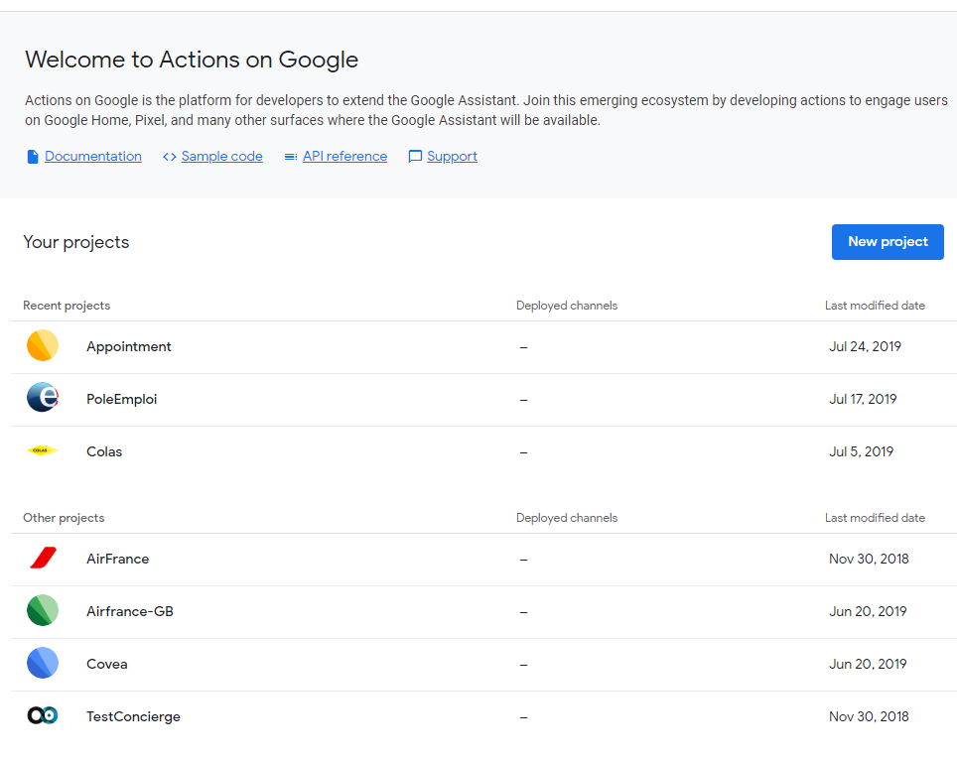
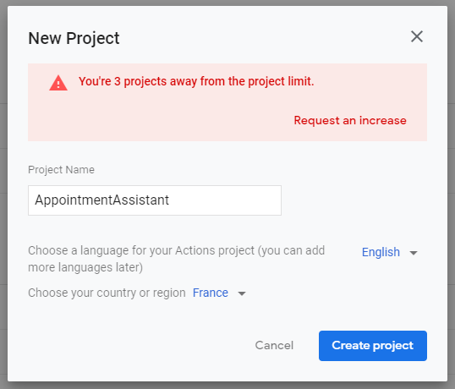
Create a new project in Google Assistant

Slide 57
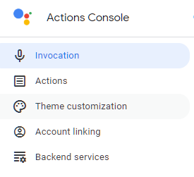
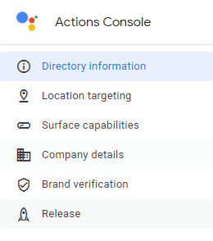
Parameter the project
How how your bot is invoked.
Link to Dialoglow agent
Icons, images, colours… for text bots
Contact, description, icons…
Develop menu
Deploy menu

Slide 58
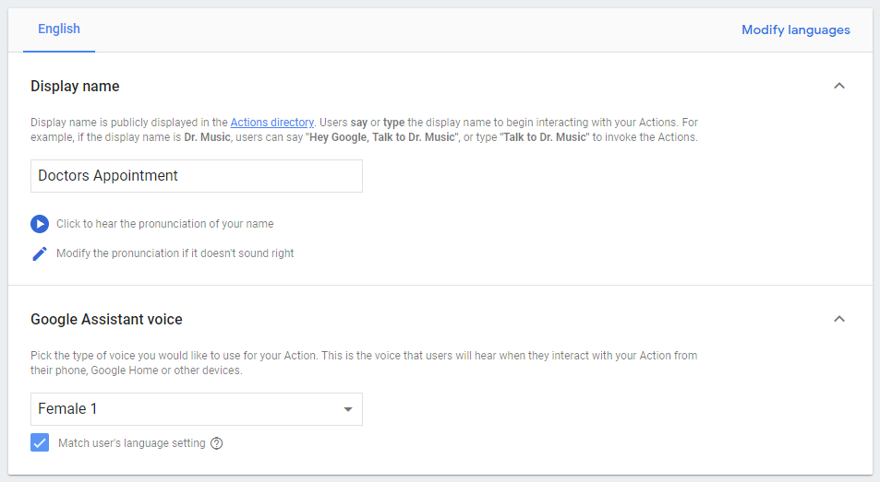
1 - Invocation
Define how your bot is invoked.
« Ok Google, talk to doctors appointment »
Choose the voice of the bot
The Google home voice can’t be used for a custom bot

Slide 59
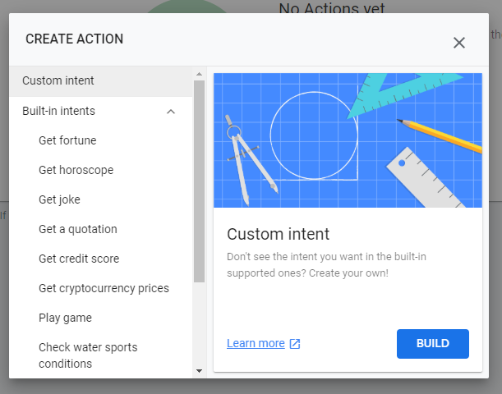


2 - Actions
Custom intent = new Dialogflow agent

Slide 60

3 – Theme customization
(Optional for a demo)

Slide 61

4 – Directory information

Slide 62

The simulator
Before testing on your own device (Google Home / Google Assistant) first you have to launch the simulator (« Test »).

Slide 63
Granting acces to the bot to users
By default, only the owner (you) can access to the new bot.
If you want to autorize new users to join your sandbox (for invoking the bot from a Google Home or from a Google Assistant), two methods :
Clean one : you can add them as « alpha users »
(« Production » and « Beta » agents must be released by Google)
Fast one : add the users as viewers of your project:
Users can invoke easily the agent
And it’s faster : they can access the agent immediately

Slide 64



Granting acces to the bot to users alpha release
Link to give to the users

Slide 65


Granting acces to the bot to users add new owner
From the GCP Console :
Gmail address
Project / viewer

Slide 66

Granting acces to the bot to users add new owner
From the Action on Google Console :
Give this url to your new user (he must enrole himself)

Slide 67
Deep links
BONUS
Users can specify the Action explicitly by its name, along with a qualifying phrase that represents a task for your Action to handle.
“Ok Google, ask to Bob the Robot to add 3 and 4”
Action name
Intent « addition»

Slide 68


Deep links
BONUS

Slide 69

Workshop : migrate you bot « Ordering Pizza » to Google Assistant
WORKSHOP
Create a new Google Assistant project
With a new dialofglow custom bot
Export your existing « ordering pizza bot » (export as Zip) and import it in the new Dialogflow bot
Test it, with the simulator (and with your Google Assistant)

Slide 70
Dialogflow Training
Module 6 : Tuning and Learning

Slide 71
How DF computes a classification
DNN
512 dimensional vector
Classes /intents
« How old are you? »
Sentence Encoder
[0.3, -0.2, 0.08 …]
Classifier
95% HOW_OLD
60% HOW_ARE_YOU
«HOW_OLD»
The Universal Sentence Encoder encodes text into high-dimensional vectors
Utilizes some training data (intents / corpus) to classify given input variables

Slide 72

Sentence Encoder / Semantic Textual Similarity
Change a card limit
Find a bank branch
Car insurance
Age

Slide 73

Tuning
ML Classification Threshold: To filter out false positive results, you can tune the machine learning classification threshold.
Intent matches have an intent detection confidence value in a range from 0.0 (completely uncertain) to 1.0 (completely certain).
If the confidence value is less than the ML classification threshold, a fallback intent is triggered.

Slide 74


Learning
With the « Learning Module », you can :
View the conversations
Add a training phrase to an intent (Fallback or bad classification)

Slide 75

Analyzing the quality of training phrases
BONUS
In a perfect world :
all sentences contained in the same intention are similar,
all intentions are clearly separated,
and there are no similar phrases in two intentions.
“A” intent
“B” intent
“C” intent
“D” intent

Slide 76

Analyzing the quality of training phrases
BONUS
TensorFlow is an open source Machine Learning library created by Google to develop and run Machine Learning and Deep Learning applications.
With Tensorflow, you can evaluate :
Cohesion: The average similarity value between each pair of phrases in the same intent. That value is computed for each intent. The higher the intent cohesion value, the better the intent training phrases.
Separation: Given two intents, the average distance between each pair of training phrases in the two intents.
Confusing phrases: Training phrases that are highly similar to training phrases in other intents.

Slide 77

Analyzing the quality of training phrases
BONUS
A 2D representation of the training phrases embeddings.

Slide 78

Analyzing the quality of training phrases
BONUS
You can find the most similar training phrases that don't belong to the same intent:
Phrases in different intents that have high similarity value can be confusing to the Dialogflow agent, and could lead to directing the user input to the wrong intent.

Slide 79
Dialogflow Training
Module 7 : Contexts

Slide 80
Ordering a dialog : graphs and contexts
Hello
Hello
Good bye
At the end of the intent : creation of a contex, with a lifetime
Order a pizza
Order a pizza
Good Bye
Type pizza
A context can be required to run into an other intent
Type pizza
Good bye
Question about the pizza
Question about the pizza
Type pizza
Graph
Contexts

Slide 81
Contexts in a few words
Contexts let you control conversation flows by letting you define specific states that a conversation must be in for an intent to match. Normally, Dialogflow matches an intent if its training phrases closely resemble the end-user expression. However, when you apply contexts to an intent, Dialogflow will only consider that intent for matching if the context is active.
There are two types of context that let you activate and deactivate contexts and can control the flow of your conversation:
Input contexts: When applied to an intent, an input context tells Dialogflow to match the intent only if the end-user expression is a close match and if the context is active.
Output contexts: When applied to an intent, an output context tells Dialogflow to activate a context if it's not already active or to maintain the context after the intent is matched.

Slide 82
Contexts in a few words
Some use cases where contexts are helpful include:
Controlling order of intent matching.
In a conversation, some intents may not be activated at the beginning
Creating different outcomes for intents with the same training phrases.
A classic use case : confirmation intents (“yes”, “I agree”…)
Restricting the choices available to the dialogue manager, and thus optimize the recognition rate of the good intention

Slide 83

Managing the output context
Output context :
Name = “Appointment_ok”
Lifespan = 5

Slide 84

Managing the input context
An input context can lock an intent. Without this context, the intent is not executed.
For example : an intent “confirm_appointment”
By default, the input context is also an output context.

Slide 85

Managing the context : demo
Fallback intent : no context “appointment_ok” available
Output context “appointment_ok” created
Ok, the required context exists

Slide 86
Lifetime / lifespan
By default, output contexts expire after either five requests or 20 minutes after its corresponding intent is matched. If the same output context is included in another intent, the context resets the counter and clock to five requests and 20 minutes. Contexts in follow-up intents have a default lifespan of two requests.
If the “like pizzas" context has a lifespan of two and the context's lifespan isn't reset by its related output, the agent could only observe "like pizzas" for two conversational turns:
"Do you like pizzas?" - Context is attached to this intent.
"Yes, I do." - Context is set and activated.
"Do you want to see a pizza picture?" - Turn 1.
"Sure!" - Turn 1.
"Here's a pizza picture." - Turn 2 and context is removed.

Slide 87


Follow-up intent
With a follow-up intent, It’s easy to :
Build quickly a subsequent dialog (with input / output context)
Add a prebuild intent (yes / no / later / repeat…)

Slide 88



Follow-up intent
New intent
with automatic input context
with default corpus

Slide 89

Testing with contexts
When testing a dialog :
You can visualize the active contexts
And you can reset all the contexts

Slide 90


Managing precisely the contexts
Output context = input context.
The context is still active, and the lifespan is the same.
No output context.
The lifespan of the context is decremented.
The context is not deleted all the time !
If you want to delete it, you must use a “0” lifespan.

Slide 91
Some hints…
Remember : a fallback decrement the lifespan on 1 (like any others intents)
Never use a lifespan of 1 : in case of fallback, you loose your context. Usually, a lifespan is between 3 and 5.
If you use smalltalks, it’s better to increase the lifespan.
If you are in a callbot, it’s better to increase the lifespan also.
An intent becomes useless ? Do not hesitate to delete the input context to avoid misunderstanding.

Slide 92
Workshop : build a mind reader bot
WORKSHOP
I want to play
Build this dialog (with only follow-up intents or intents with input/output contexts)
Test :
« I want to play »
« yes »
« yes »
Think to a number between 1 and 4 (included). Is it a pair number ?
Yes
No
It is lower to 3 ?
It is lower to 2 ?
Yes
No
Yes
No
It’s 2 !
It’s 4 !
It’s 1 !
It’s 3 !

Slide 93
Dialogflow Training
Module 8 : Firebase Cloud Functions

Slide 94
Cloud Functions for Firebase
Cloud Functions for Firebase let you automatically run backend code in response to events triggered by Firebase features and HTTPS requests.
Your code is stored in Google's cloud and runs in a managed environment. There's no need to manage and scale your own servers.
https://firebase.google.com/docs/functions

Slide 95
Node.js in brief
Node.js is an open-source and cross-platform JavaScript runtime environment.
Node.js runs the JavaScript engine, the core of Google Chrome, outside of the browser.
A Node.js app is run in a single process, without creating a new thread for every request. Node.js provides a set of asynchronous I/O primitives in its standard library that prevent JavaScript code from blocking and generally, libraries in Node.js are written using non-blocking paradigms, making blocking behavior the exception rather than the norm.
When Node.js needs to perform an I/O operation, like reading from the network, accessing a database or the filesystem, instead of blocking the thread and wasting CPU cycles waiting, Node.js will resume the operations when the response comes back.
https://nodejs.dev/

Slide 96


Why node.js ?
AWS (Lambda)
Java,
Node.js
C#
Python
(others languages on roadmap)
GCP (Firebase functions)
Node.js. That’s all !
Cloud functions includes also Python. But DF is natively interfaced with "Firebase functions“ only… Wait & see !

Slide 97

Limitations
Remember to change the billing mode of Firebase :
A WS call is primarily an outgoing stream
Google charges outflows ($ 0.12 / GB).
The "free" mode of Firebase is not enough anymore.
The “Blaze Formula” is recommended

Slide 98


Integration with Dialogflow
Two files :
index.js : all the functions
package.json : all the dependencies
Default “index” and “package” files are created automatically.

Slide 99


Warning : the default versions of dependencies could be older
A recent file
Default file
Some functions can be deprecated (like « setContext »).

Slide 100


Focus on dependencies
index.js
dialogflow-fulfillment
actions-on-google
package.json
Dialogflow Fulfillment makes creating fulfillment for Dialogflow agents for chat and voice platforms on Node. Dialogflow Fulfillment also manages the context functions.
Actions on Google manages Actions for the Google Assistant only. Dialogflow-fulfillment uses actions-on-google.

Slide 101


Consulting the logs

Slide 102

Firebase status dashboard
Usefull link, if :
You can’t deploy a function,
You can’t connect to console,
You have a timeout…
https://status.firebase.google.com/

Slide 103
Dialogflow Training
Module 9 : Fulfillments

Slide 104
Fulfillment definition
If your agent needs more than static intent responses, you need to use fulfillment to connect your service to your agent. Connecting your service allows you to take actions based on end-user expressions and send dynamic responses back to the end-user.
For example, if an end-user wants to schedule a haircut on Friday, your service can check a database and respond to the end-user with availability information for Friday.
Each intent has a setting to enable fulfillment. If an intent requires some action by your system or a dynamic response, you should enable fulfillment for the intent.
When an intent with fulfillment enabled is matched, Dialogflow sends a request to your webhook service with information about the matched intent. Your system can perform any required actions and respond to Dialogflow with information for how to proceed.

Slide 105

Fulfillment definition

Slide 106

Enabling webhook
Each intent has a setting to enable fulfillment.
When webhook is enabled, the default text response is only used is case or error in the webhook.
It’s a good idea to use a specific default text response to detect easily errors.

Slide 107

Enabling inline editor
You can use :
your own webhook (GCP cloud functions… or AWS Lambda)
Firebase functions, with the inline Editor.

Slide 108

Mapping intent / code
The mapping between the name of the intent and the function is done at the end of the node.js file.
To activate a new webhook (if you start from scratch in the editor):
Uncomment the line "intentMap" and change the name of the intent and the name of the function
Uncomment the "yourFunctionHandler" function and adapt it to your needs

Slide 109

Mapping intent / code
agent.add (text) : send a response
agent.end (text) : send a response / end the conversation

Slide 110

Some usefull functions
agent.query () : get the user’s request
console.log (text) : add a new line in Firebase Log
agent.parameters.<Name_Parameter> : get a parameter defined in the intent

Slide 111

Example of REST request

Slide 112
Workshop : adding numbers
WORKSHOP
Hello, may I help you?
Create an “Addition” intent, with 2 parameters : number1 and number2
Both parameters are mandatory
Create a fulfillment for this intent
In the fulfillment :
Get the two parameters,
Write them into the logs,
Give the correct answer
Tips : use parseInt() to convert a String to an Int
I would like to add 12 and 11
Easy ! It’s 23 !
(End of conversation)

Slide 113
Managing contexts with node.js
Create a context, with parameters :
let oContext = {'name’: ‘context-name', 'lifespan’: 5,'parameters': {‘myTxt’:’Hello world’} };
Get a context :
Delete a context :
agent.setContext(oContext); | agent.context.set(oContext);
agent.getContext.(‘context-name’); agent.getContext('context-name').parameters.myTxt; | agent.context.get ('context-name’); agent.context('context-name').parameters.myTxt;
agent.setContext({'name’: context-name’, 'lifespan': 0}) | agent.context.delete('context-name')

Slide 114
Some hints…
Remember : a fallback decrement the lifespan on 1 (like any others intents)
Never use a lifespan of 1 : in case of fallback, you loose your context. Usually, a lifespan is between 3 and 5.
If you use smalltalks, it’s better to increase the lifespan.
When you modify a context in an intent, the new content of the context can be read only in the next intent.
This doesn't work :
let oContext = {'name': 'retranscription', 'lifespan’: 5,'parameters’: {‘value’:’My value’ } };
agent.context.set(oContext);
sValue = agent.context.get('retranscription').parameters.value;
An intent becomes useless ? Do not hesitate to delete the input context to avoid misunderstanding.

Slide 115
Keeping information across conversations
If your Action needs to save state between turns of a conversation or across different conversations, you can use the UserStorage.
The userStorage field is a string that is saved across conversations for a particular user.
For example, a game can save the highest score of a user in userStorage, and use its value in the welcome message every time the user starts a new conversation.
Warning:
Only verified users can store information in userStorage.
If the user is a guest, accessing userStorage will fail.
Consequently:
We can’t use UserStorage with Concierge/Dialogflow (no identified user)
With a Google Home or a Google Assistant, if you use a sandbox, your user is a verified user.

Slide 116



Keeping information across conversations
Write:
Read:
Delete all:

Slide 117
Workshop : using context storage
WORKSHOP
Hello, may I help you?
I would like to order a thuna pizza
In the fulfillment, Create a context named « order », with a lifespan of 99
Use a single string, to record the pizzas ordered :
« thuna pizza »
« thuna pizza and cheese pizza »
« thuna pizza and cheese pizza and … »
You ordered : thuna pizza. Do you want anything else ?
I would like to order a cheese pizza
You ordered : thuna pizza and cheese pizza. Do you want anything else ?
( … )
(End of conversation)

Slide 118
Dialogflow Training
Module 10 : Using Google APIs

Slide 119
Natural language API
Natural Language uses machine learning to reveal the structure and meaning of text.
You can extract information about people, places, and events, and better understand social media sentiment and customer conversations.
Natural Language enables you to analyze text and also integrate it with your document storage on Google Cloud Storage.
https://cloud.google.com/natural-language/?hl=en
For sentiment analysis, the API can give a « sentiment score », from -1.0 to 1.0

Slide 120

Natural language API
Natural Language API in natively included in the « Enterprise Editions » of Dialogflow. All the sentences are tested with this API.
But we can use sentiment analysis with « standard Edition ».
We have to manage the calls to the API.
Use case :
If we are in a fallback intent, two cases :
The sentiment is positive, the bot asks to reformulate
The sentiment is negative, the bot proposes a transfert to an agent

Slide 121

Natural language API

Slide 122
Firebase Realtime Database
Store and sync data with a NoSQL cloud database. Data is synced across all clients in realtime, and remains available when your app goes offline.
The Firebase Realtime Database is a cloud-hosted database. Data is stored as JSON and synchronized in realtime to every connected client. When you build cross-platform apps with our iOS, Android, and JavaScript SDKs, all of your clients share one Realtime Database instance and automatically receive updates with the newest data.
https://cloud.google.com/natural-language/?hl=en
Less powerful than a classic relational database (no constraints, no transactions, no integrity rules, no index, no ordering, no complex SQL…)
But… it’s a 100% REST Database !

Slide 123

Firebase realtime database

Slide 124


Firebase Realtime Database
Writing
Reading

Slide 125

Cloud DLP API – Data Loss Prevention
Cloud DLP helps you better understand and manage sensitive data. It provides fast, scalable classification and redaction for sensitive data elements like credit card numbers, names, social security numbers, US and selected international identifier numbers, phone numbers, and GCP credentials.
Cloud DLP classifies this data using more than 90 predefined detectors to identify patterns, formats, and checksums, and even understands contextual clues. You can optionally redact data as well, using techniques like masking, secure hashing, tokenization, bucketing, and format-preserving encryption.
https://cloud.google.com/dlp/?hl=en

Slide 126
Cloud DLP API – Data Loss Prevention
Use case :
Retrieve the user's request,
anonymize the sensitive data
For example, the phone number
before saving this user request in the logs.
« My phone number is 06 01 02 03 04 »
« My phone number is XX XX XX XX XX »

Slide 127

Cloud DLP API – Data Loss Prevention
Intention :
function ask_callback(agent) {
var query = agent.query;
log_DLP (query);
agent.add(« Ok, I call you back.");
}
intentMap.set(ask_callback ', ask_callback);

Slide 128
Dialogflow Training
Module 11 : Integration with Concierge

Slide 129
Dialogflow + Odigo Concierge
GW
Proxy
IVR
application
ASR Nuance NR9
TTS Acapela 7
IVR designer
Text only
(no voice)
ASR Nuance NR11
TTS Acapela 8.2
STT Google
TTS Google
Legacy IVR platform
Obsolete legacy component
Callbot & NLP on-demand
Backend Connector
Dialog Manager
NLU
Q&A repository
NLP on-demand to come
Bot « core product »
Third party Bot connector
DialogFlow Connector
Admin UI
NLP
ADMIN & BACKEND
DIALOG MANAGEMENT

Slide 130
Exemple of integration
With Action On Google (Google Home / Google Assistant), DF receives a “welcome intent” event and triggers the “default intent”. Concierge does not use the default intent.
Welcome message from Concierge (« Hello, can I help you ? »)
First word
The dialog is managed by Dialogflow, until the end of the conversation.
First response from DF
Second word
Second response from DF + end of conversation
End message from Concierge (« Good bye »)

Slide 131
How to create a voice bot with Concierge
Concierge Team
Dialogflow Team
Create or duplicate an existing “Concierge Instance” (IVR + Concierge)
Set the Welcome / Good bye messages on Concierge
Integrate the “Json” key
Create a specific Dialogflow agent
With specific end of conversation : back to Concierge, or transfer to an agent
With conversation recording (if needed)
For a voice bot, the silence management
Export a json key to Concierge

Slide 132

Welcome / good bye messages
These messages are modified with the Back Office (Concierger Dialog / Language Generation)
https://concierge-demodigitale.prosodie.com/concierge-discover-ui/home/

Slide 133


Creating the .json
On the service account page creation (https://console.cloud.google.com), add the role 'Dialogflow API Client' and create a new private key (Type : JSON).

Slide 134



Creating the .json

Slide 135

Silence management
Question ?
With a Concierge Voicebot, the query “_SILENCE_” is sent to Dialogflow.
The easy way to manage this : add a test into the fallback intent
(Silence)
Cunning plan: use two different answers in your fallback :
A specific “silence” answer
A default answer, in case of no understanding.

Slide 136

End of conversation
“End of conversation” + “=skill=“ in the response :
Concierge vocalize the answer (without “=skill”)
Concierge transfer to an agent with the skill “skill”
“End of conversation”, without any skill
Concierge vocalize the good bye text

Slide 137
Dialogflow Training
Module 12 : Integration with Odigo

Slide 138

Sending SMS with Odigo Campaign
Possibility of sending an SMS.
For testing : we have a demonstration Campaign account (not suitable for sending many SMS messages)
“sMessage” must be url-encoded.

Slide 139

Asking a callBack
Parameters:
Phone number to call
Odigo Skill
Message to display on the console

Slide 140

Add a conversation widget
Firebase Database
XMLHttpRequest()
<html>…
</html>
1
2
HTML
3
https://rules.prosodie.com/assets/voice_chat/conversations_V2.html?BSN=0683206134
4
end of conversation
(key= phone number)
Transfer / Callback / Search
Each exchange (default / fallback / custom intent) is recorded in the context.
At the end of the conversation, the whole text is recorded (HTML).
The widget is an HTML page :
https//rules.prosodie.com/explorer
https://rules.prosodie.com/assets

Slide 141

Add a conversation widget
Each intent must have a fulfillment
Each function must use the “traite_Echange” function to respond to the user.
This function answers AND records the dialog into Firebase Database
Do not use “agent.add()” directly
Traite_Echange (agent, User query text, Response text, true=end of conversation)

Slide 142
Add a conversation widget
In Firebase Realtime Database, the key is :
conversations/phone_number/date
For a demonstrations, add a “conversation widget” to each client used in Odigo Console
The key is the customer’s phone number (Bsn)

Slide 143


Add a conversation widget
You can find all the widgets here:
https://rules.prosodie.com/explorer
The conversation widget :
Voice_chat
You can use it “as is”, but if you want customize it please create a new directory and copy the files. Do not modify the files in “voice_chat”

Slide 144



Add a conversation widget
Url = https://rules.prosodie.com/assets/voice_chat/conversations_V2.html
Bsn = phone number

Slide 145
Add a conversation widget
Select older conversations

Slide 146
Workshop
WORKSHOP
From your bot “ordering Pizza”, add a conversation recording
Of course, the phone-number is hardcoded
From your “Digital Demo”,
Modify a contact, and add a conversation widget (with BSN=the previous phone number)
Test your bot (default + fallback + ordering pizza) and consult the contact screen.
Free : you can use the existing database !

Slide 147
Dialogflow Training
Module 13 : Tips and tricks

Slide 148
Saving and restoring agents
You can easily save and restore an agent with the “export as…” and “import as…” functions.
These options do not save and restore the node.js fulfillments. You have to manage yourself theses files.
These options do not save and restore “knowledge base” connectors.

Slide 149
Sentences to use
Things to know :
Concierge Voice (actual version) does not like short sentences (a “yes” or a “no” could be too short to be detected)
Google Speech To Text gives better result with long sentences
“I prefer to speak to an agent” is better than a simple “yes”

Slide 150


Dates
Without any year, Dialogflow supposes the date is in the future.
We are August 8 2019 :

Slide 151

Mega Agents
Need to build a complex agent, with several conversational trees ?
Need to have several developers on a same agent ?
Need to have more than 2000 intents ?
You can build a “mega agent” : you can combine multiple Dialogflow agents, called sub-agents, into a single agent, called a mega agent. When you perform a detect intent request against a mega agent, all of the sub-agents are considered, and the best response from the sub-agents is returned.
Limits :
One GCP project by mega agent and sub-agents
max 10 sub-agents
no small-talks

Slide 152
Links
Google Cloud Status Dashboard
https://status.cloud.google.com/
Firebase Status Dashboard
https://status.firebase.google.com/
Samples
https://github.com/dialogflow
Assessing the quality of training phrases
https://cloud.google.com/solutions/assessing-the-quality-of-training-phrases-in-dialogflow-intents
SSML
https://developers.google.com/assistant/actions/reference/ssml

Slide 153
Eric Ginouillac
Odigo Experience Presales
eric.ginouillac@odigo.com

